Slide 1
OWASP Top 10 Risks and Secure Coding

Slide 2

OWASP Top 10 Security Risks
1. Broken Access Control
2. Cryptographic Failures
3. Injection
4. Insecure Design
5. Security Misconfiguration
6. Vulnerable and Outdated Components
7. Identification and Authentication Failures
8. Software and Data Integrity Failures
9. Server-Side Request Forgery (SSRF)
10. Insufficient Logging and Monitoring

Slide 3
Secure Coding
Secure Coding involves writing software that is resistant to attacks and minimizes vulnerabilities.
Key Principles
Validate Inputs: Always validate and sanitize user inputs to prevent injection attacks.
Least Privilege: Grant only the minimum access necessary for code execution.
Error Handling: Avoid exposing sensitive details in error messages.

Slide 4
Secure Coding
Common Threats Addressed
Injection Attacks (SQL, Command, etc.)
Cross-Site Scripting (XSS)
Cross-Site Request Forgery (CSRF)
Insecure Authentication and Session Management
Coding Best Practices
Use secure libraries and frameworks.
Avoid hardcoding sensitive data (e.g., passwords, API keys).
Regularly update and patch dependencies.

Slide 5
Secure Coding
Security Testing
Static and dynamic code analysis.
Penetration testing and vulnerability scans.
Benefits of Secure Coding
Reduces risk of exploitation.
Protects user data and privacy.
Enhances system reliability and compliance.

Slide 6
Real-Life Scenarios

Slide 7
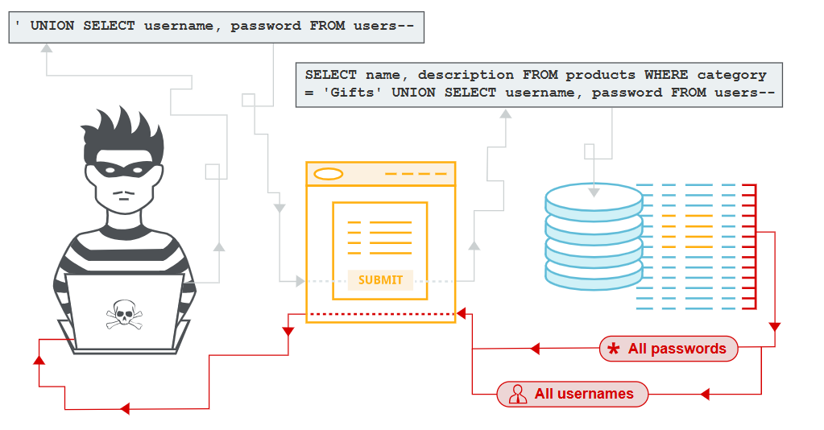
1. Injection Attacks
Scenario:
SQL injection on an e-commerce site.

Slide 8
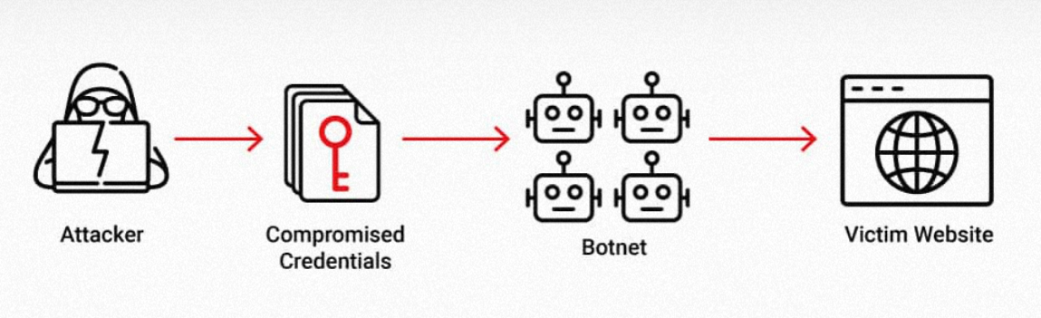
2. Broken Authentication
Scenario: Weak authentication on a social media platform.

Slide 9
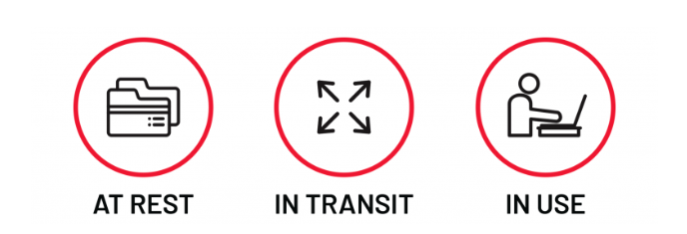
3. Sensitive Data Exposure
Scenario: Unencrypted medical records on a healthcare provider's site.

Slide 10
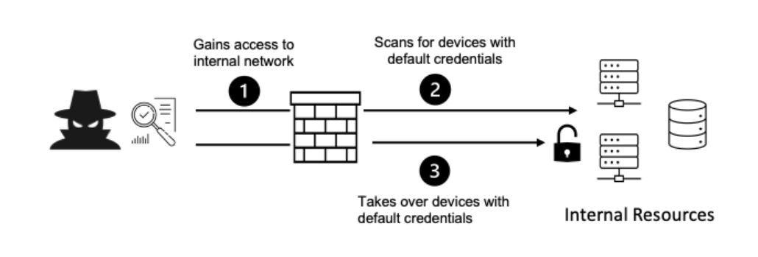
4. Security Misconfigurations
Scenario: Financial institution's server with default settings.

Slide 11
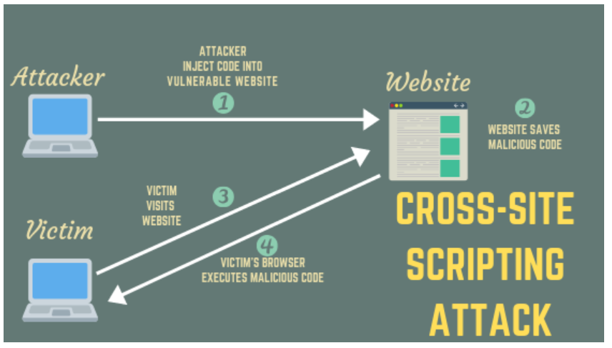
5. Cross-Site Scripting (XSS)
Scenario: Malicious scripts in comments on a news website.

Slide 12
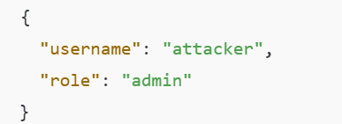
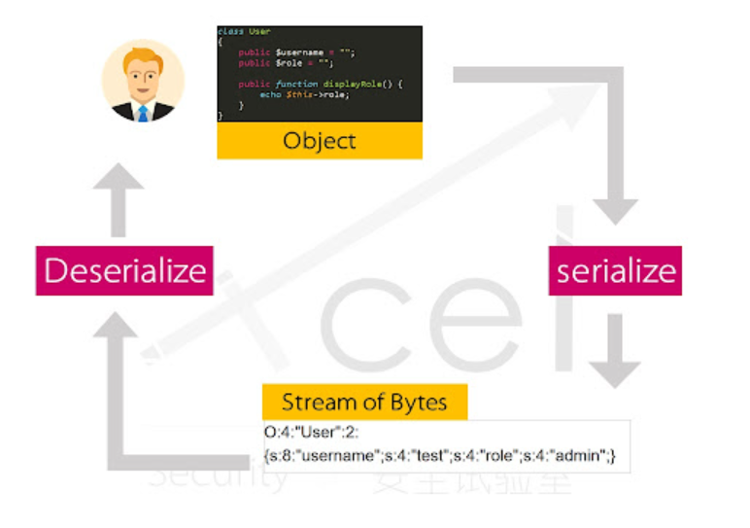
6. Insecure Deserialization
Scenario: Online gaming platform with insecure deserialization.

Slide 13
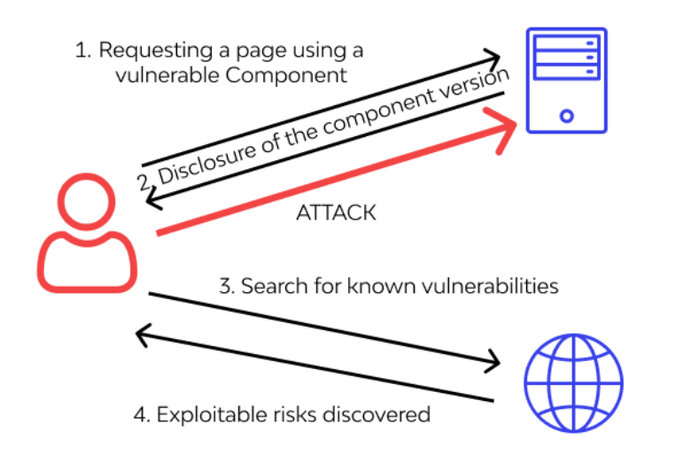
7. Using Components with Known Vulnerabilities
Scenario: Outdated libraries in a software development company's application
.

Slide 14
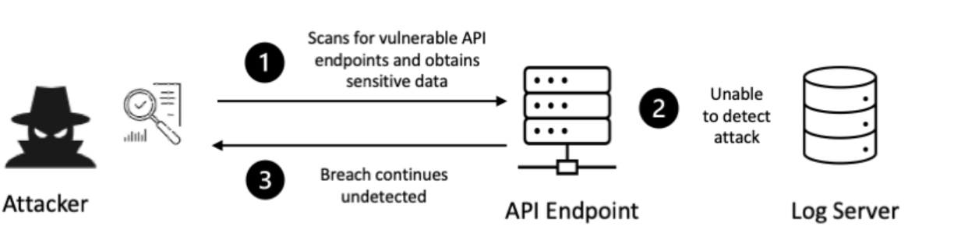
8. Insufficient Logging and Monitoring
Scenario: Retail website without proper logging.

Slide 15
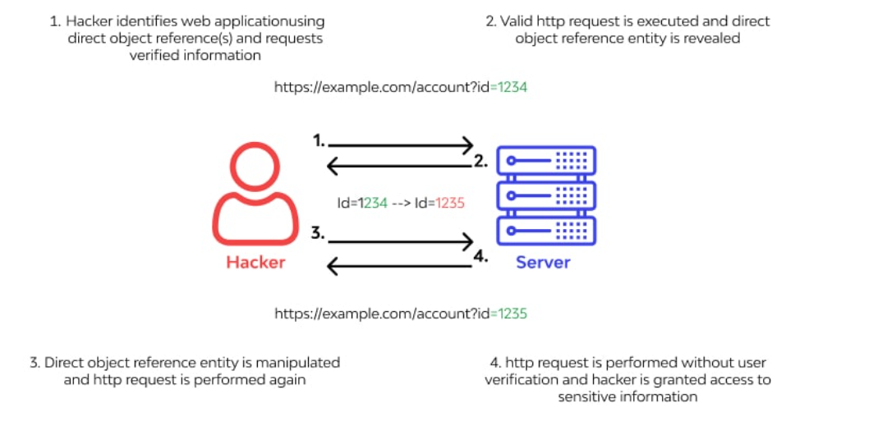
9. Insecure Direct Object References (IDOR)
Scenario: Cloud storage service with direct references.

Slide 16
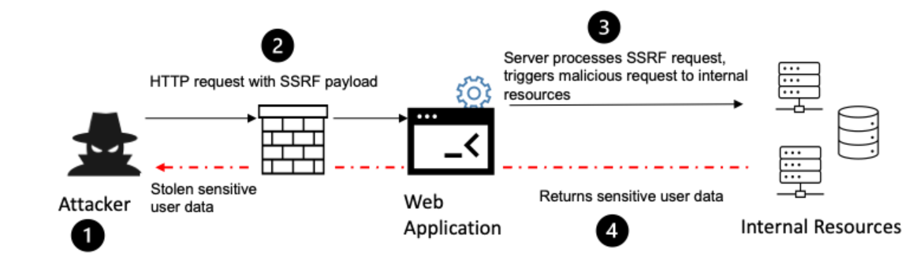
10. Server-Side Request Forgery (SSRF)
Scenario: Web application allowing internal service requests.

Slide 17
Conclusion
Vulnerabilities Can Have Far-Reaching Impacts
Proactive Measures Are Crucial
Security Is a Shared Responsibility
Testing and Continuous Monitoring Are Essential
Adhering to Best Practices Reduces Risk
Compliance and Legal Considerations
User Trust and Business Continuity
Continuous Improvement

